Slide 1
Kimball - datawarehouse

Slide 2
Business Requirements
“We have mountains of data in this company, but we can’t access it.”
“We need to slice and dice the data every which way.”
“You’ve got to make it easy for business people to get at the data directly.”
“Just show me what is important.”
“It drives me crazy to have two people present the same business metrics
at a meeting, but with different numbers.”
“We want people to use information to support more fact-based decision
making.”

Slide 3
Business Requirements
The data warehouse must make an organization’s information easily accessible.
The data warehouse must present the organization’s information consistently.
The data warehouse must be adaptive and resilient to change.
The data warehouse must be a secure bastion that protects our information assets.
The data warehouse must serve as the foundation for improved decision making.
The business community must accept the data warehouse if it is to be deemed successful.

Slide 4
Strategy
Understand your users by business area, job responsibilities, and computer tolerance.
Determine the decisions the business users want to make with the help of the data warehouse.
Identify the “best” users who make effective, high-impact decisions using the data warehouse.
Find potential new users and make them aware of the data warehouse.
Choose the most effective, actionable subset of the data to present in the data warehouse, drawn from the vast universe of possible data in yourorganization.
Make the user interfaces and applications simple and template-driven,

Slide 5
Strategy
Make sure the data is accurate and can be trusted, labeling it consistently across the enterprise.
Continuously monitor the accuracy of the data and the content of the delivered reports.
Search for new data sources, and continuously adapt the data warehouse to changing data profiles, reporting requirements, and business priorities.
Take a portion of the credit for the business decisions made using the data warehouse, and use these successes to justify your staffing, software, and hardware expenditures.
Publish the data on a regular basis.
Maintain the trust of business users.
Keep your business users, executive sponsors, and boss happy explicitly matching to the users’ cognitive processing profiles.

Slide 6
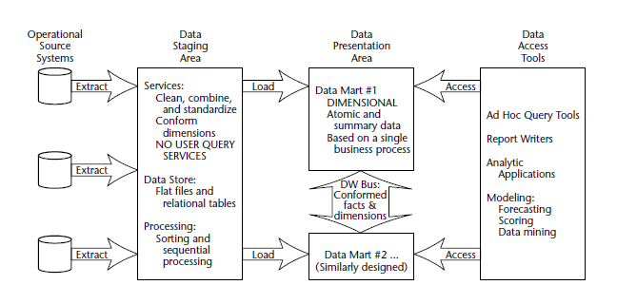
Basic elements of the data warehouse

Slide 7
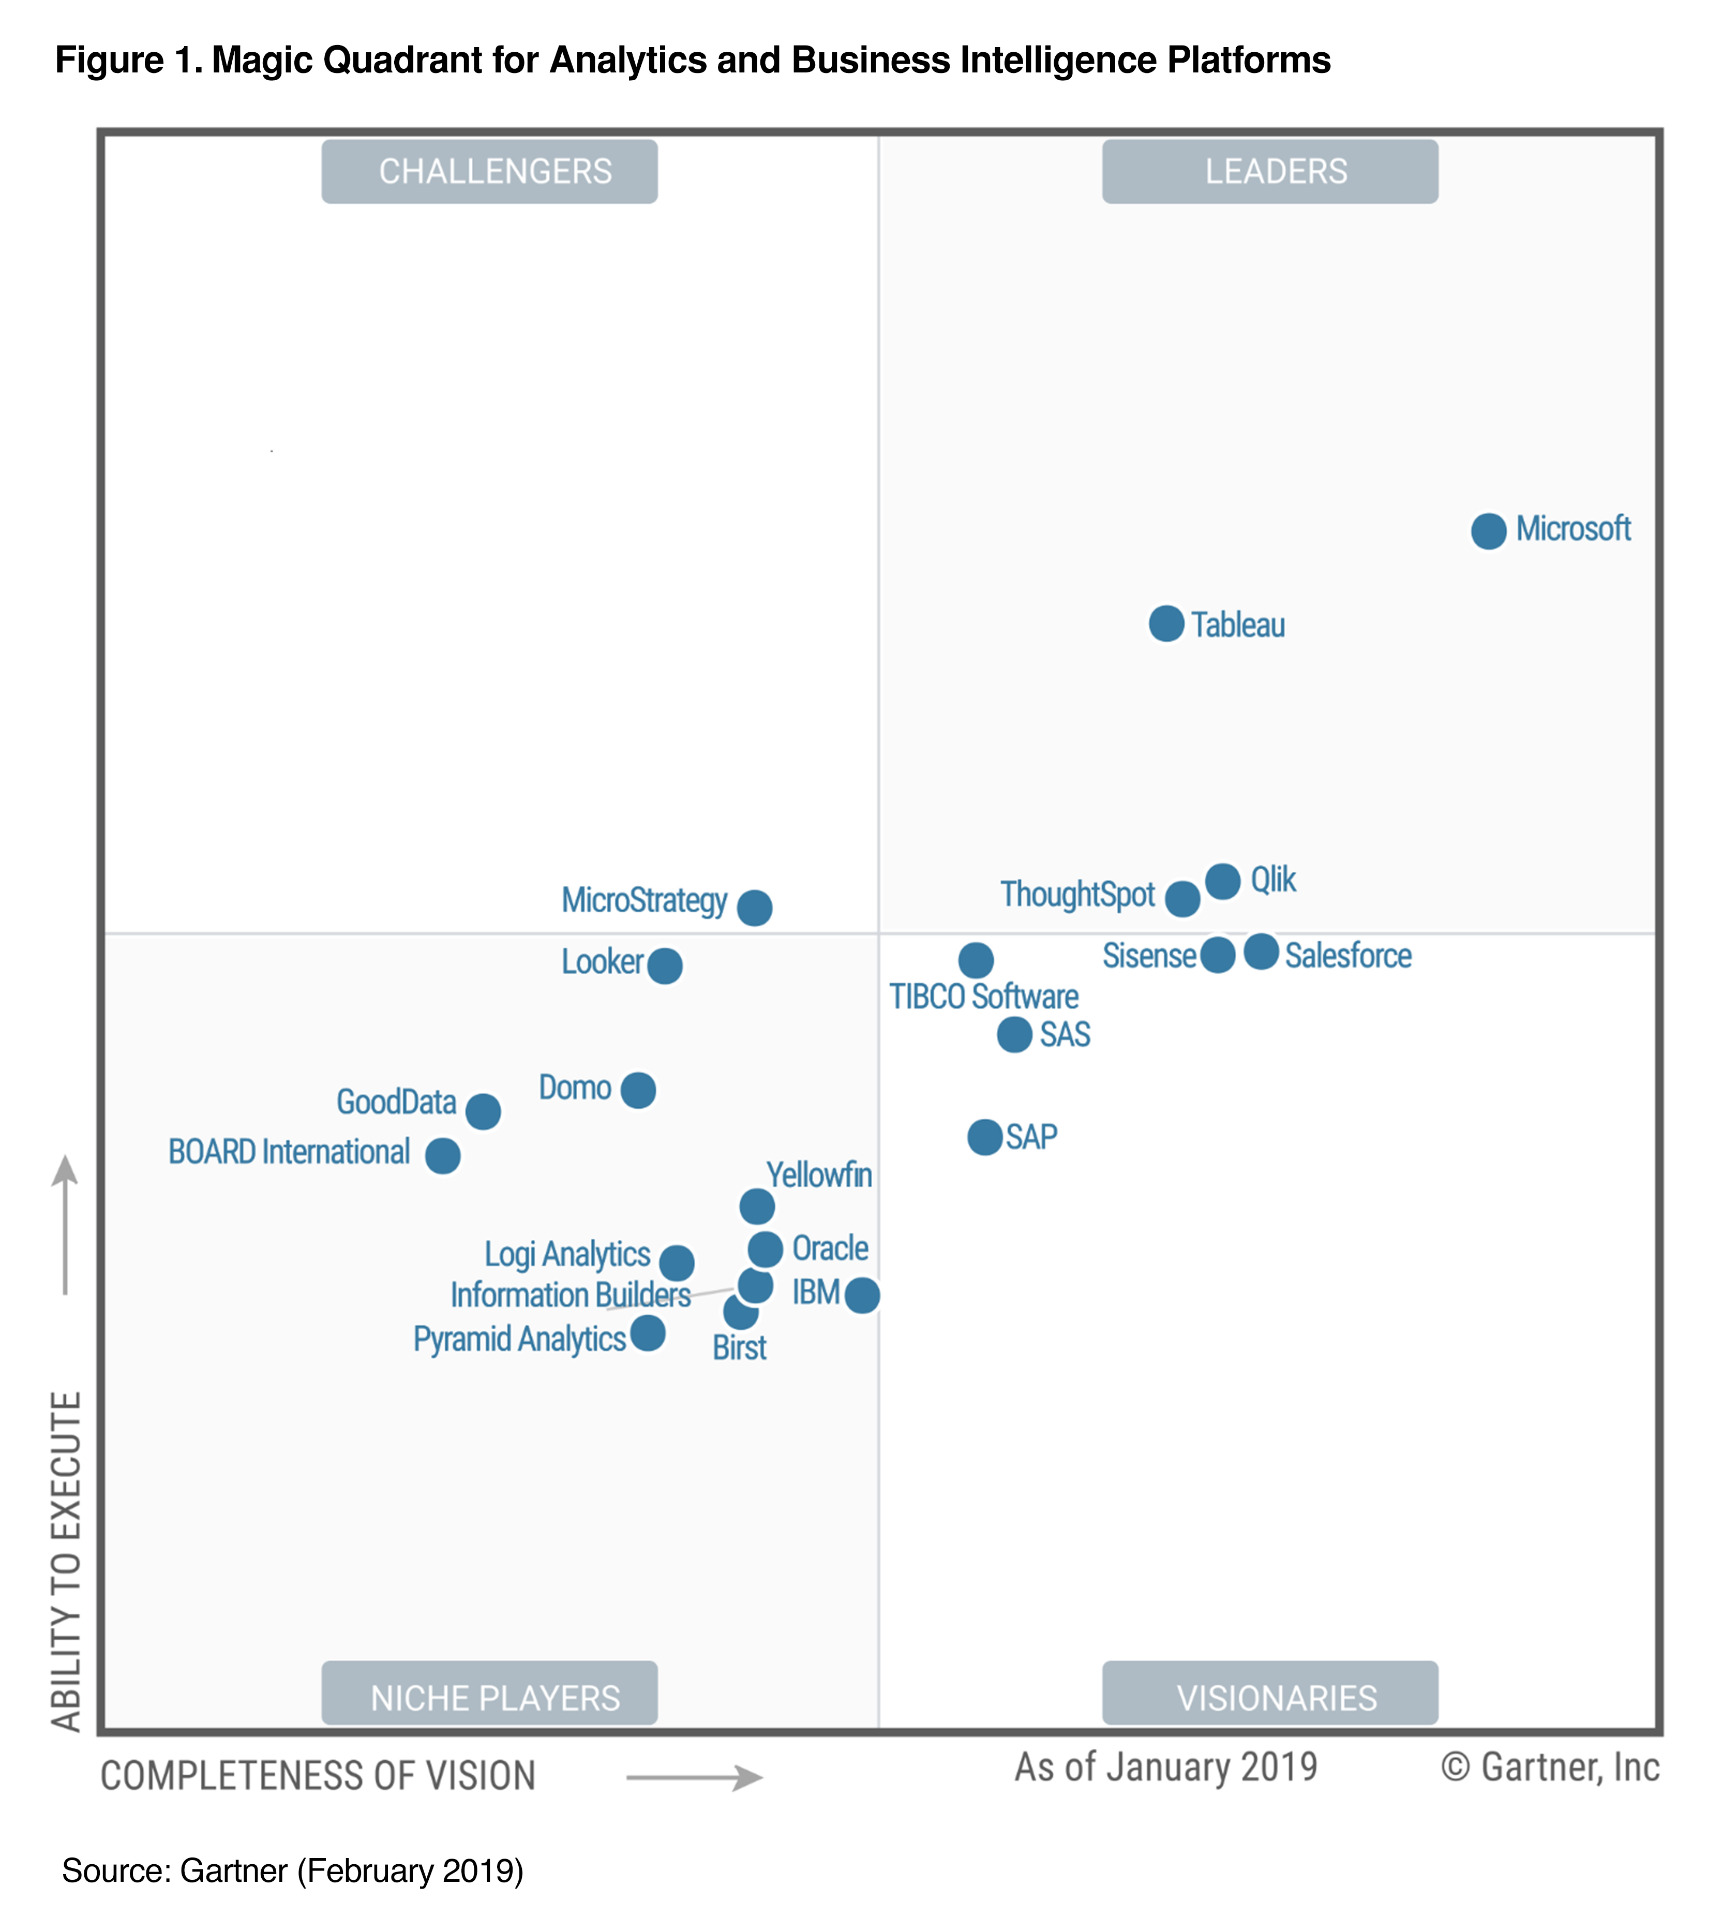
Microsoft Power BI
Getting data
Modeling
Visualizations
Exploring data

Slide 8
Staging area (kitchin)
The data staging area is everything between the operational source systems and the data presentation area.
Staging area might contains files or tables in any form.
The key architectural requirement for the data staging area is that it is off-limits to business users and does not provide query and presentation services.

Slide 9
Data cleansing
Data cleansing:
Correcting misspellings
Resolving domain conflicts
Dealing with missing elements
Parsing into standard formats
Combining data from multiple sources
Deduplicating data
Assigning warehouse keys

Slide 10
Staging in 3rd normal form
It is acceptable to create a normalized database to support the staging processes; however, this is not the end goal.
The normalized structures must be off-limits to user queries because they defeat understandability and performance.
As soon as a database supports query and presentation services, it must be considered part of the data warehouse presentation area.
By default, normalized databases are excluded from the presentation area, which should be strictly dimensionally structured.

Slide 11
Data Presentation
The data presentation area is where data is organized, stored, and made available for direct querying by users, report writers, and other analytical applications.

Slide 12
Dimensional Model
Makes databases simple and understandable.
Adimensional model contains the same information as a normalized model but packages the data in a format whose design goals are user understandability, query performance, and resilience to change.
All the data marts must be built using common dimensions and facts, which we refer to as conformed.
Data in the queryable presentation area of the data warehouse must be dimensional must be atomic, and must adhere to the data warehouse bus architecture.

Slide 13
Dimensional Modelling

Slide 14
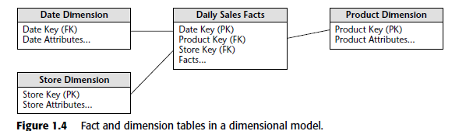

Slide 15
Surrogate Key
Wikipedia: A surrogate key (or synthetic key, entity identifier, system-generated key, database sequence number, factless key, technical key, or arbitrary unique identifier^{[citation needed]}) in a database is a unique identifier for either an entity in the modeled world or an object in the database. The surrogate key is not derived from application data, unlike a natural (or business) key which is derived from application data.

Slide 16
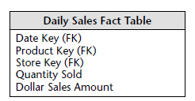
Fact Table
A fact table is the primary table in a dimensional model where the numerical performance measurements of the business are stored
The most useful facts in a fact table are numeric and additive
Fact tables express the many-to-many relationships between dimensions in dimensional models.

Slide 17
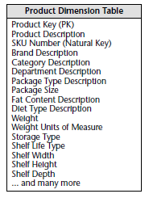
Dimension Tables
The dimension tables contain the textual descriptors of the business.
Dimension tables are the entry points into the fact table.
Robust dimension attributes deliver robust analytic slicing and dicing capabilities.
The dimensions implement the user interface to the data warehouse.

Slide 18
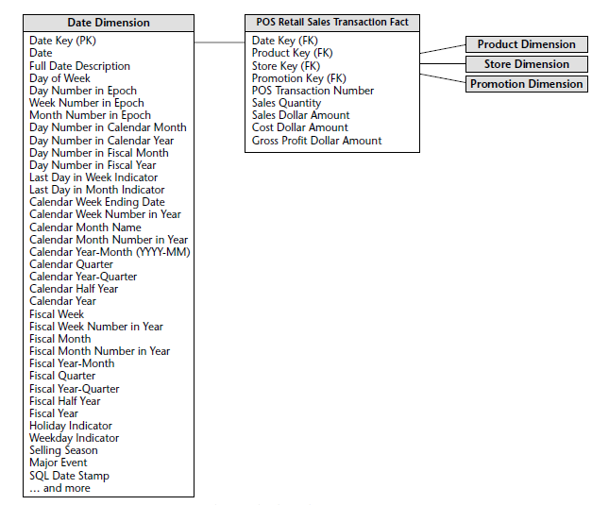
Data Dimension
Every process has a time perspective

